Slide 1

Introduction to Robotics
2016 Fall

Slide 2
Project Roadmap
Class | Date | Project | Finished?
1 | 9/06/16 | Introduction of Robot and Robotics, mBot Assembly | yes
2 | 9/13/16 | Introduction of mBlock | yes
3 | 9/20/16 | Play an Octave | yes
4 | 9/27/16 | Push a Button | yes
5 | 10/04/16 | Light Sensor, UltraSonic Sensor | yes
6 | 10/11/16 | Drive with Remote, Line Following | yes
7 | 10/18/16 | Robot Movement 1 | yes
8 | 10/25/16 | Robot Movement 2, Trace a Shape | yes
9 | 11/01/16 | Obstacle Avoidance | yes
10 | 11/08/16 | Sumo Wrestling 1
11 | 11/15/16 | Sumo Wrestling 1
12 | 11/22/16 | Maze
13 | 11/29/16 | Servo and other sensors
14 | 12/06/16 | C Programming
15 | 12/13/16 | Robotics in the future

Slide 3
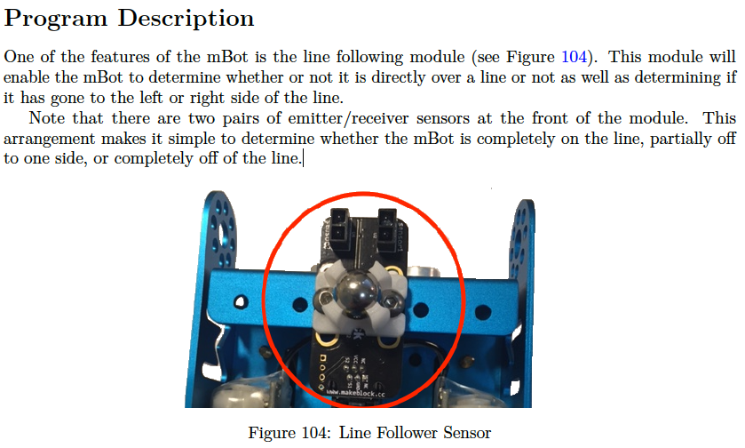
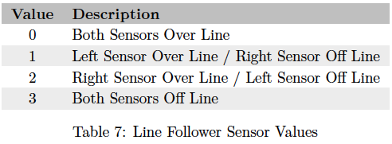
Line Follower Sensor

Slide 4
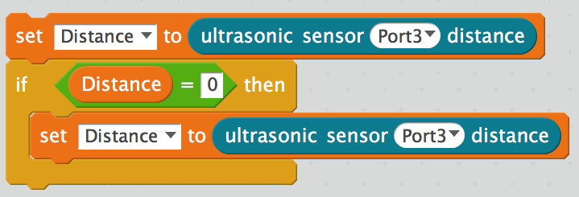
Ultrasonic Sensor: Read distance from object in front

Slide 5
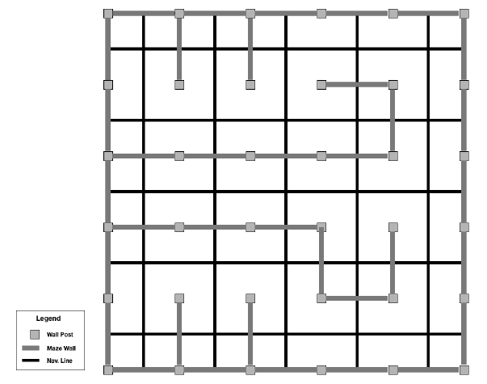
Maze
1. Start from anywhere
2. End at
https://www.youtube.com/watch?v=yx6JtQVpcUw
https://www.youtube.com/watch?v=-r_k_iSjfeI

Slide 6
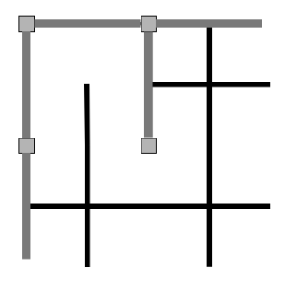
End of the Maze

Slide 7
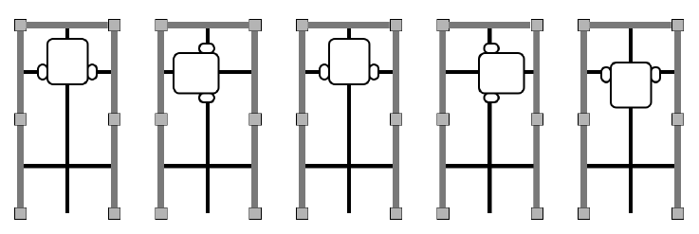
Dead-End Strategy
1. Wall detected in front of mBot
2. mBot executes a left turn but detects a wall
3. mBot executes a right turn but detects a wall
4. mBot executes a right turn but detects a wall
5. mBot executes a right turn

Slide 8
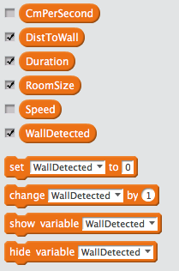
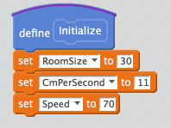
Implement: Variables and Initialization
How far (in centimeters) the mBot moves under the speed used
Distance value read from the ultrasonic sensor (in cm)
How many seconds mBot keeps moving
Wall to wall room size in centimeters
mBot moving speed
If a wall has been detected

Slide 9
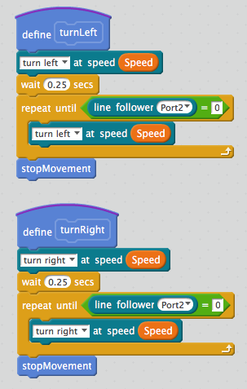
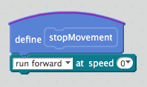
Implement: turn left or right until a line is found
Keep turning until a line is detected

Slide 10
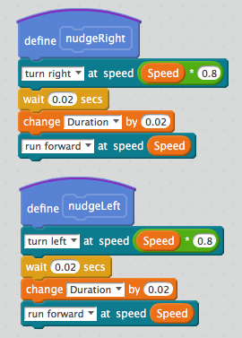
Implement: nudge left or right slightly
Turn a little bit

Slide 11
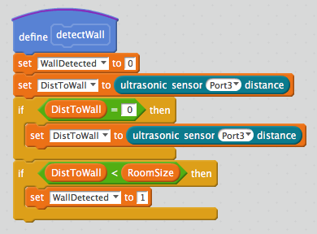
Implement: Detect wall with ultrasonic sensor

Slide 12
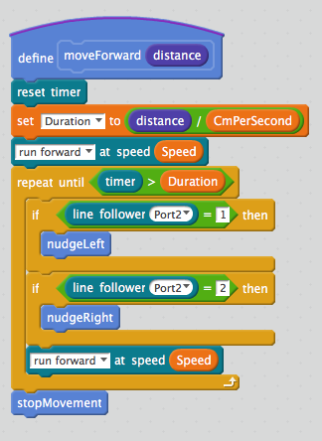
Implement: Move forward (for one room distance)

Slide 13
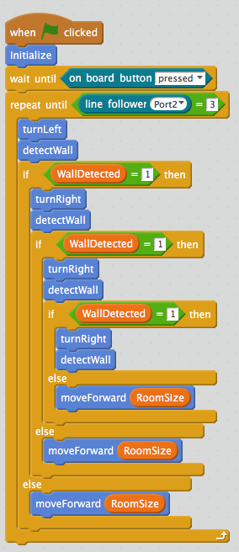
Implement: Main Program Logic
Initialize variables
Press the button to start
Stop if a end point is found (no line detected)
Check if there is a wall on the left
Check the right side until an open path is found
Open path, move forward for one room distance

Slide 14
Challenges

